Slide 1
GAME: QUICK EYES
Write the names of the festivals you have seen
Easter
Tet
names of the festivals
Christmas
Birthday

Slide 2


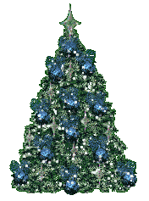

UNIT 13: FESTIVALS
Reading
CHRISTMAS

Slide 3
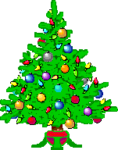
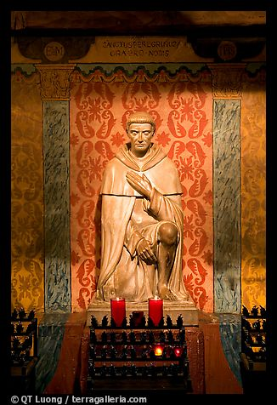
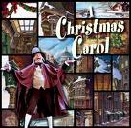
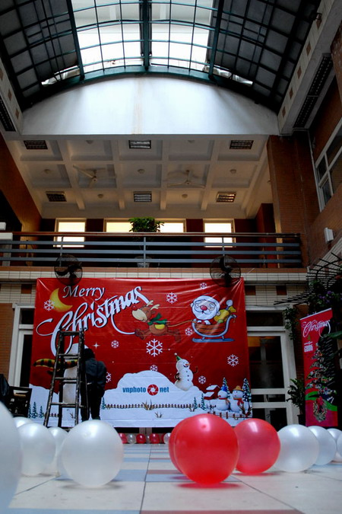
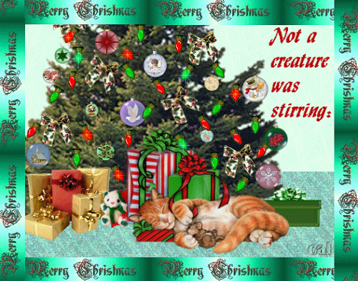
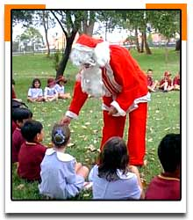

: Unit 13: FESTIVALS Lesson 4: READ
I. Pre – reading:
1. Pre – teach:
The Christmas tree
Cây thông Noel
The Christmas card
Thiếp mừng Noel
Christmas Carols
Những bài hát thánh ca Giáng sinh
Santa Claus
Ông già Noel
Wishing you a very Happy and warm Christmas
The Patron saint
Thánh đỡ đầu
(to) decorate
Trang trí

Slide 4
Wishing you a very Happy and warm Christmas
2, Patron saint
1, Christmas card
3, Santa Claus
4, Christmas Carols
5, Christmas tree (n)
6, Decorate

Slide 5
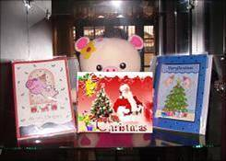
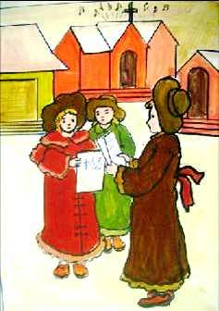
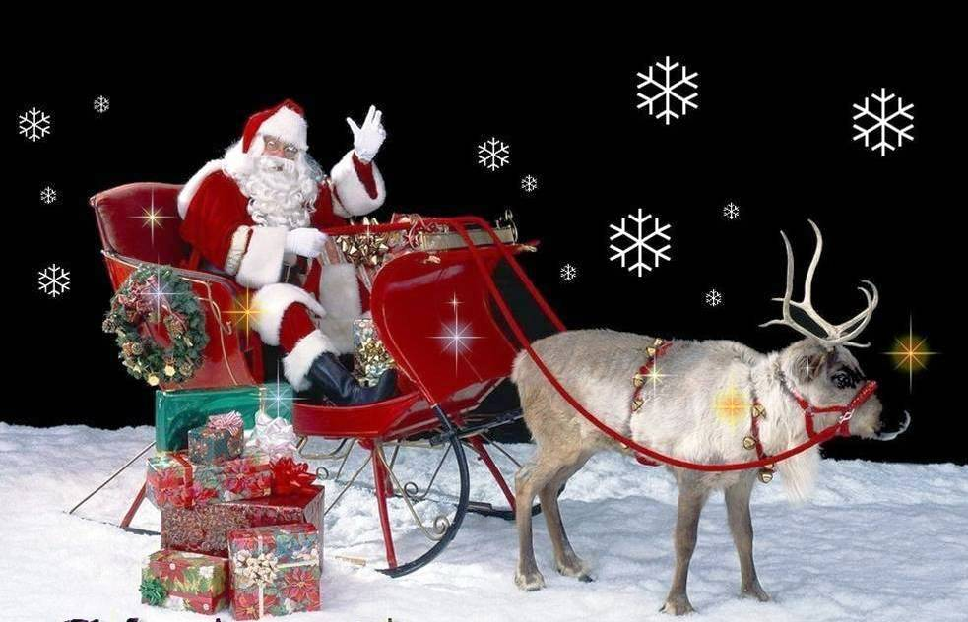
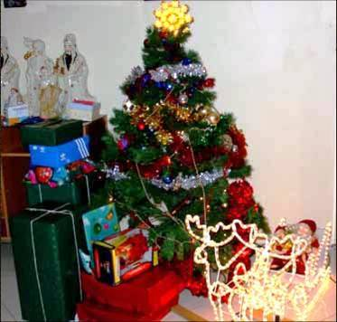
II. While - reading:
Christmas is an important festival in many countries around the word.

Slide 6

II. WHILE - READING.
1. Listen and check.
The Christmas Tree
One Christmas Eve in the early 1500s, some people decorated a tree and put it in the market place in the Latvian city of Riga. This custom spread throughout Europe, and finally to America the 1800s
The Christmas Card
In the mid-nineteenth century, an Englishman wanted to send Christmas greetings to his friends, so he had someone design a card. Forty years later, cards were a part of the Christmas tradition
Christmas Carols
Eight hundred years ago, Christmas songs were performed for people in towns and villages. These songs were stories put to music and most people enjoyed them. The leaders of the Church, however, did not. They said the songs were unsuitable, but about 180 years ago, the songs became popular again.
Santa Claus
In 1823, the patron saint of children, Saint Nicholas appeared in a poem called A Visit From Saint Nicholas. The character in the poem was a fat jolly man who wore a red suit and gave children presents on Christmas Eve. The poem, which was written by Clement Clarke Moore, an American professor, became popular in the USA. Santa Claus is based on the description of Saint Nicholas in this poem.

Slide 7


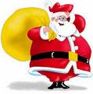
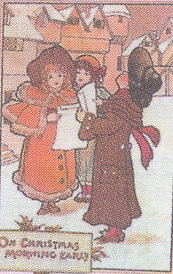
1. Listen and check.
Christmas tree
Christmas card
Christmas Carols
Santa Claus

Slide 8
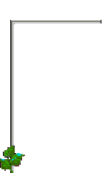


Unit 13: FESTIVALS Lesson 4: READ
2. Complete the table.
Christmas Specials | Place of origin | Date
 | Riga
 |  | mid-19th century
Christmas carols
 | The USA
Designed by J. Horsley
The Christmas Tree
early 1500s
The Christmas Card
England
(no information)
800 years ago
Santa Claus
1823

Slide 9
III. Post - reading:
Questions:
a. How long ago did the Christmas tree come to the USA ?
b. Why did the Englishman have someone design a card ?
c. When were Christmas songs first performed?
d. Who wrote the poem A Visit from Saint Nicholas?
e. What is Santa Claus based on ?

Slide 10

home work
Write it up:
- Use the information in the map to write the brief paragraphs.
- Learn grammar: passive voice
Do exercises 1,5,6 in the workbook.
- Prepare Unit 13 : Write

Slide 11
HOMEWORK
1, Use the information in the map to write the brief paragraphs
2, Learn passive voice to do exercises 1,6,5
3, Prepare - write

Slide 12

lucky number

Slide 13

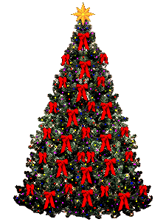
How long ago did the Christmas tree come to the USA?
More than a century ago

Slide 14
Why did the Englishman have someone design a card?
He wanted to send
Christmas greetings to
his friends

Slide 15
When were Christmas songs first performed?
800 years ago

Slide 16
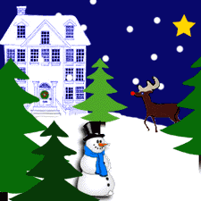
lucky number

Slide 17

Who wrote the poem A Visit from
Saint Nicholas?
An American professor Clement Clarke Moore

Slide 18

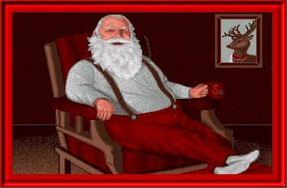
What is Santa Claus based on?
On the description of Saint Nicholas in professor Moore’s poem

Slide 19



Lucky number

Slide 20
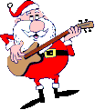
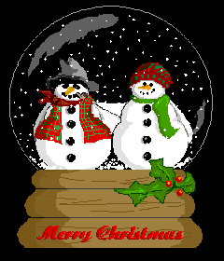

lucky number

Slide 21

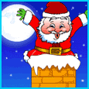

lucky number

Slide 22
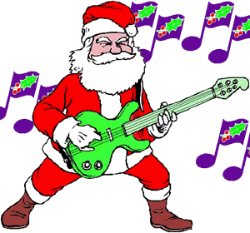
Filling the missing words in the song
Jingle Bells
Dashing though the snow
In a one – horse open sleigh,
O’er the fields we go
Laughing all the way
........... on bobtail ring,
Making spirits bright,
What fun it is to ride and .........,
A sleighing song ...........
Jingle Bells! Jingle Bells!
Jingle all the way!
.........., what fun it is to ride
In a one – horse open sleigh!
1
Bells
2
sing
3
to night !
4
Oh

Slide 23
home work
Write it up:
Use the information in the grid to write the brief paragraphs.

